Slide 1
Memory organization
I2

Slide 2
What is a memory?
A memory unit is the collection of storage units or devices together. The memory unit stores the binary information in the form of bits. Generally, memory/storage is classified into 2 categories:
Volatile Memory: This loses its data, when power is switched off.
Non-Volatile Memory: This is a permanent storage and does not lose any data when power is switched off.

Slide 3
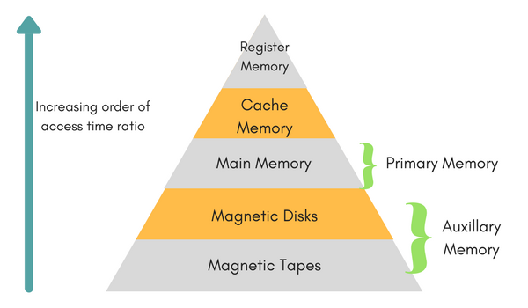
Memory hierarchy
Auxiliary memory access time is generally 1000 times that of the main memory, hence it is at the bottom of the hierarchy.
The main memory occupies the central position because it is equipped to communicate directly with the CPU and with auxiliary memory devices through Input/output processor (I/O).
The cache memory is used to store program data which is currently being executed in the CPU. Approximate access time ratio between cache memory and main memory is about 1 to 7~10

Slide 4
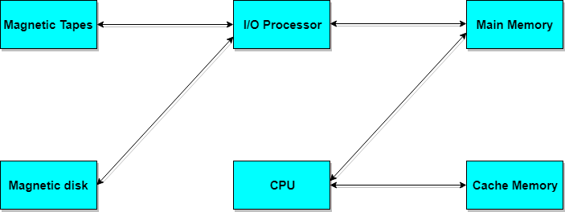

Slide 5
Auxiliary Memory
Devices that provide backup storage are called auxiliary memory. For example: Magnetic disks and tapes are commonly used auxiliary devices. Other devices used as auxiliary memory are magnetic drums, magnetic bubble memory and optical disks.
It is not directly accessible to the CPU, and is accessed using the Input/Output channels.

Slide 6
Cache memory
The data or contents of the main memory that are used again and again by CPU, are stored in the cache memory so that we can easily access that data in shorter time.
Whenever the CPU needs to access memory, it first checks the cache memory. If the data is not found in cache memory then the CPU moves onto the main memory. It also transfers block of recent data into the cache and keeps on deleting the old data in cache to accommodate the new one.

Slide 7
Associative memory
It is also known as content addressable memory (CAM).
It is a memory chip in which each bit position can be compared. In this the content is compared in each bit cell which allows very fast table lookup.
Since the entire chip can be compared, contents are randomly stored without considering addressing scheme. These chips have less storage capacity than regular memory chips.

Slide 8
Memory access methods
Each memory type, is a collection of numerous memory locations. To access data from any memory, first it must be located and then the data is read from the memory location.
Random Access: Main memories are random access memories, in which each memory location has a unique address. Using this unique address any memory location can be reached in the same amount of time in any order.
Sequential Access: This methods allows memory access in a sequence or in order.
Direct Access: In this mode, information is stored in tracks, with each track having a separate read/write head.

Slide 9
Main memory
It is the central storage unit of the computer system. It is a large and fast memory used to store data during computer operations. Main memory is made up of RAM and ROM, with RAM integrated circuit chips holing the major share.
RAM: Random Access Memory
DRAM: Dynamic RAM, is made of capacitors and transistors, and must be refreshed every 10~100 ms. It is slower and cheaper than SRAM.
SRAM: Static RAM, has a six transistor circuit in each cell and retains data, until powered off.
NVRAM: Non-Volatile RAM, retains its data, even when turned off. Example: Flash memory.

Slide 10
Main memory
Static RAM (SRAM)
a bit of data is stored using the state of a flip-flop.
Retains value indefinitely, as long as it is kept powered.
Mostly uses to create cache memory of CPU.
Faster and more expensive than DRAM.

Slide 11
Main memory
Dynamic RAM (DRAM)
Each cell stores bit with a capacitor and transistor.
Large storage capacity
Needs to be refreshed frequently.
Used to create main memory.
Slower and cheaper than SRAM.

Slide 12
Let’s search around
Go search in google and find the different products which can be considered as SRAM and DRAM

Slide 13
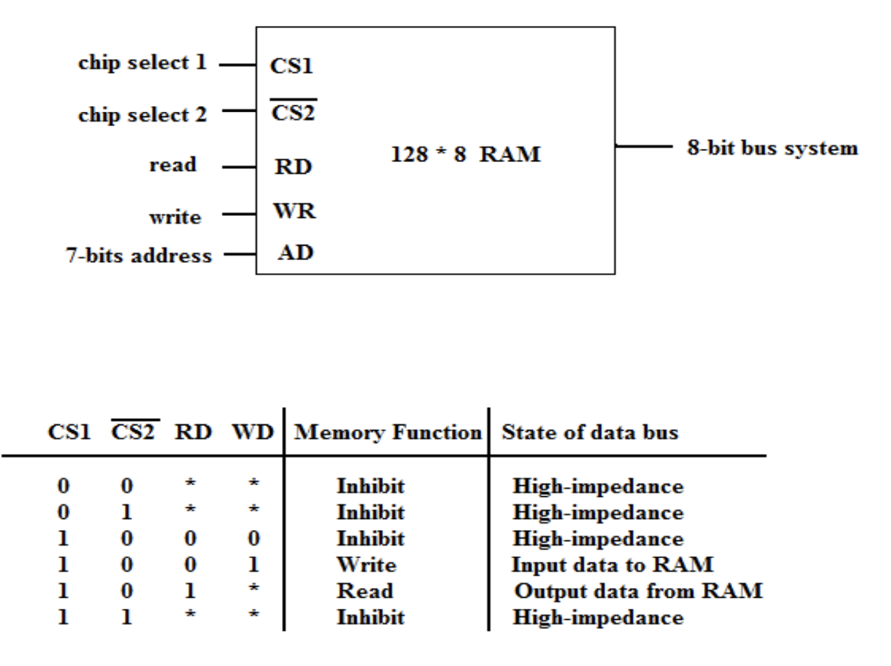
RAM : the capacity of the memory is 128 words of 8 bits (one byte) per word

Slide 14
Main memory
ROM: Read Only Memory, is non-volatile and is more like a permanent storage for information. It also stores the bootstrap loader program, to load and start the operating system when computer is turned on.
Some commonly used ROMs :
PROM(Programmable ROM)
EPROM(Erasable PROM)
EEPROM(Electrically Erasable PROM)

Slide 15
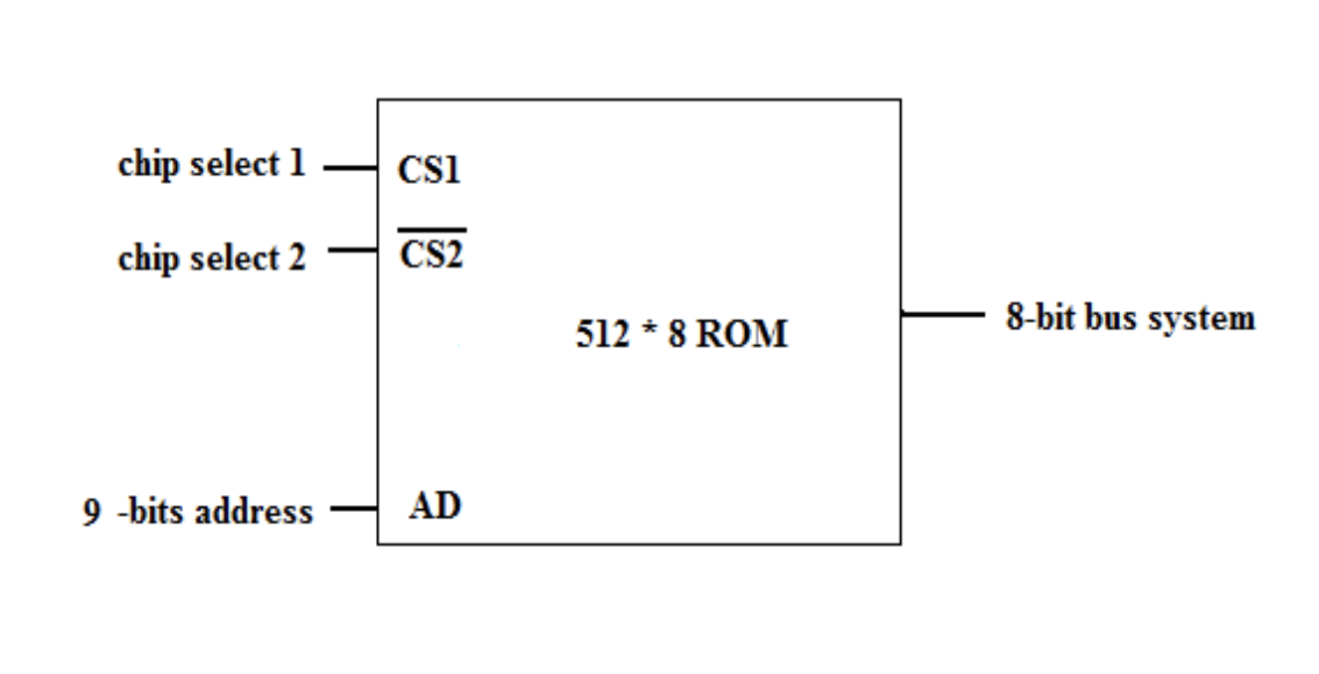
ROM

Slide 16

Hit ratio
The performance of cache memory is measured in terms of a quantity called hit ratio. When the CPU refers to memory and finds the word in cache it is said to produce a hit. If the word is not found in cache, it is in main memory then it counts as a miss.
The ratio of the number of hits to the total CPU references to memory is called hit ratio.

Slide 17
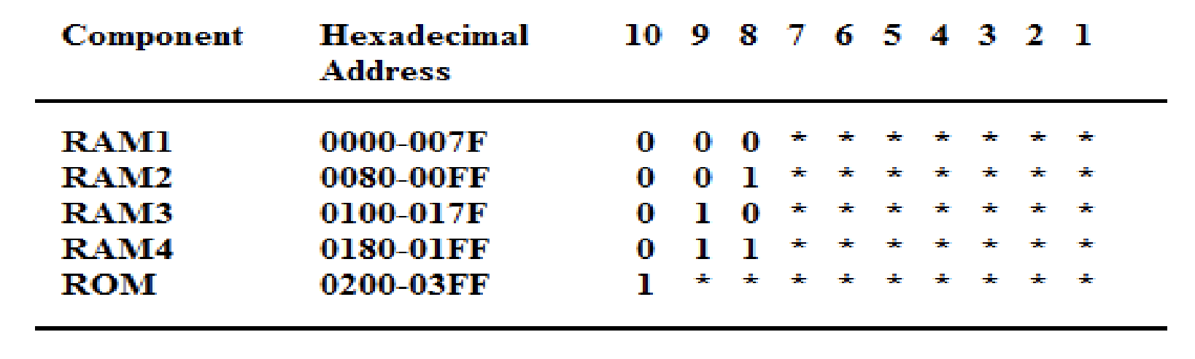
Memory Address Map
Memory Address Map is a pictorial representation of assigned address space for each chip in the system
To demonstrate an example, assume that a computer system needs 512 bytes of RAM and 512 bytes of ROM
The RAM have 128 byte and need seven address lines, where the ROM have 512 bytes and need 9 address lines

Slide 18
Memory Address Map
The hexadecimal address assigns a range of hexadecimal equivalent address for each chip
Line 8 and 9 represent four distinct binary combination to specify which RAM we chose
When line 10 is 0, CPU selects a RAM. And when it’s 1, it selects the ROM

Slide 19
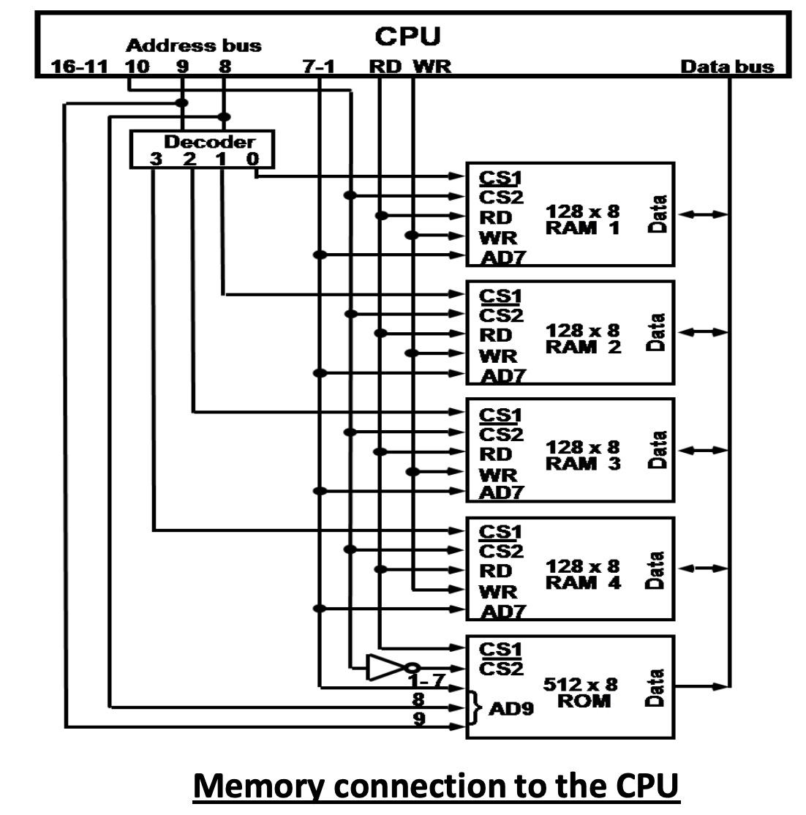

Slide 20
Main memory selection
A main memory can be built of a single or many memory modules.
A main memory module is built of an address decoder and a set of memory locations.
The locations store words of bits of data assigned to consecutive addresses.
Organization structures of main memories can be divided, according to the circuit that selects memory locations, into the following types:
Main memory with linear selection (with a single address decoder)
Main memory with two-dimensional selection (with two address decoders)
Main memory with linear selection of multiple words (with a single address decoder and a selector)

Slide 21
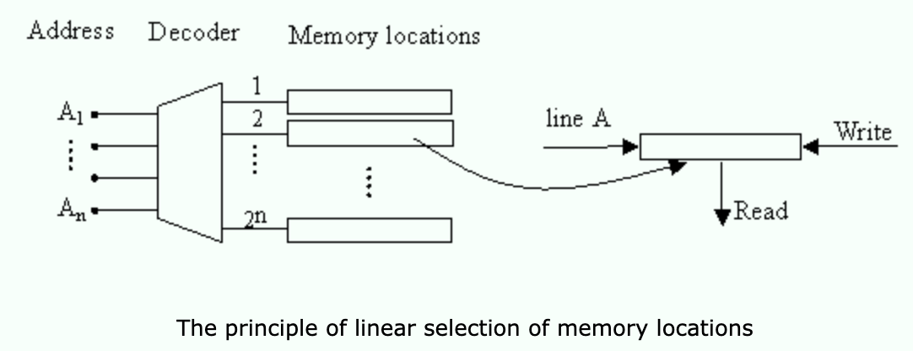
Main memory selection
Main memory with linear selection
A block diagram of the main memory module with linear selection is shown at the left. Information is stored in a matrix of data word locations. The matrix can be represented as a two-dimensional set of elementary bit locations. That is why this type of memory is called sometime a 2D main memory.

Slide 22
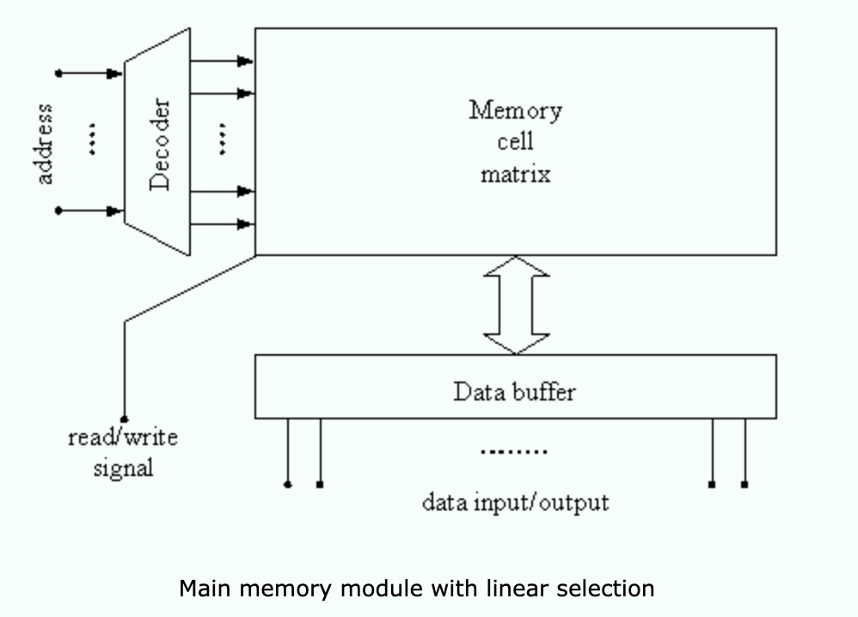
Main memory selection
Main memory with linear selection
To the inputs of the address decoder, the address bus of a processor is connected. The read/write signal is provided by the processor through the control bus.
At the output of the memory cell matrix, a buffer register is placed connected to the external data bus of the processor. It stores the data read from the memory or those which are to be there written.

Slide 23
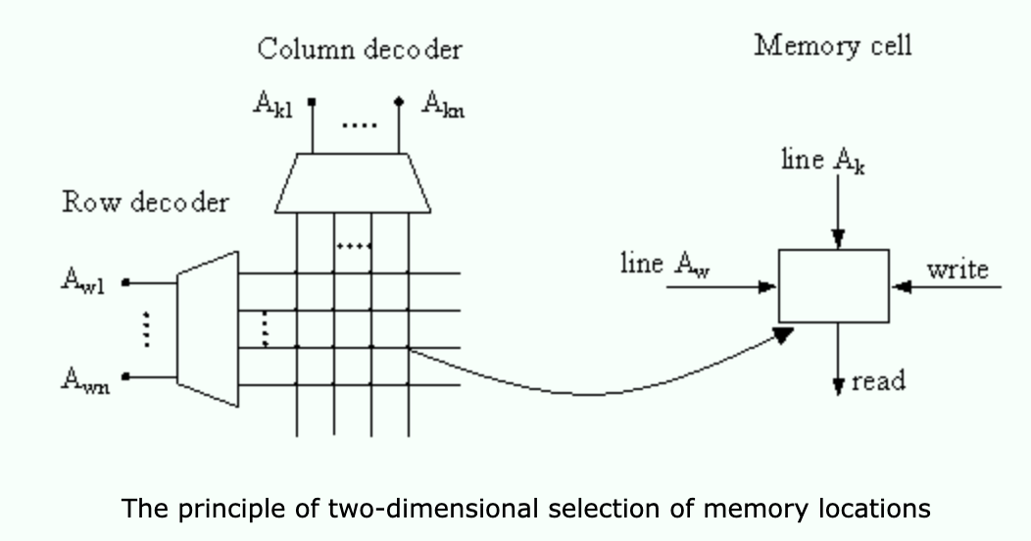
Main memory selection
Main memory with two-dimensional selection
The name of this memory comes from the fact that each address of memory location is divided into the row address and the column address in a memory matrix, in which a given location can be found (at the intersection of the row and column)
two address decoders are used: one for the row address and another for the column address.
After decoding of the address two lines coming from the decoders are activated. Bits of all words at the same bit position are stored in bit cells placed in the same rectangular bit cell matrix called a bit plane.
Notes:
The name of this memory comes from the fact that each address of memory location is divided into the row address and the column address in a memory matrix, in which a given location can be found (at the intersection of the row and column). In a memory module of this type, two address decoders are used: one for the row address and another for the column address. After decoding of the address two lines coming from the decoders are activated. Bits of all words at the same bit position are stored in bit cells placed in the same rectangular bit cell matrix called a bit plane. The memory module contains as many planes as many bits are in the memory word. To each cell in a bit plane the following lines are connected: one line from the rows decoder, one line from columns decoder, read/write control lines. The lines from decoders are replicated as many times as many bit planes are in the memory module. The read or write in bit cells of a given word takes place at the same time.

Slide 24
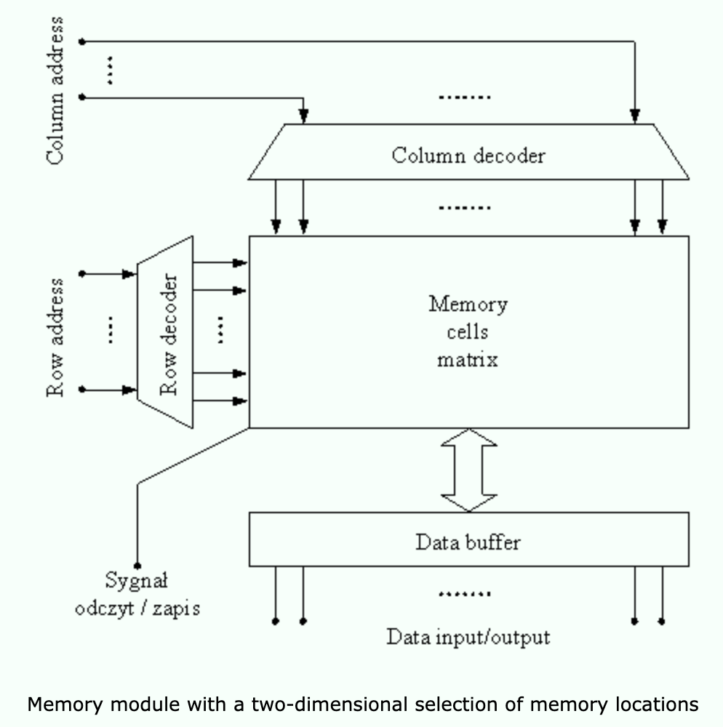
Main memory selection
Main memory with two-dimensional selection
Each pair of output lines from the row and column decoders selects (activates) a sequence of bit cells that belong to planes of consecutive bits in a memory word. In such memory module, the full matrix of bit cells has three-dimensional structure. That is why such type of main memory is called a 3D memory. The general block diagram of such memory is shown below. As in the memory with linear selection, at data outputs of the 3D memory data buffer register is placed.

Slide 25
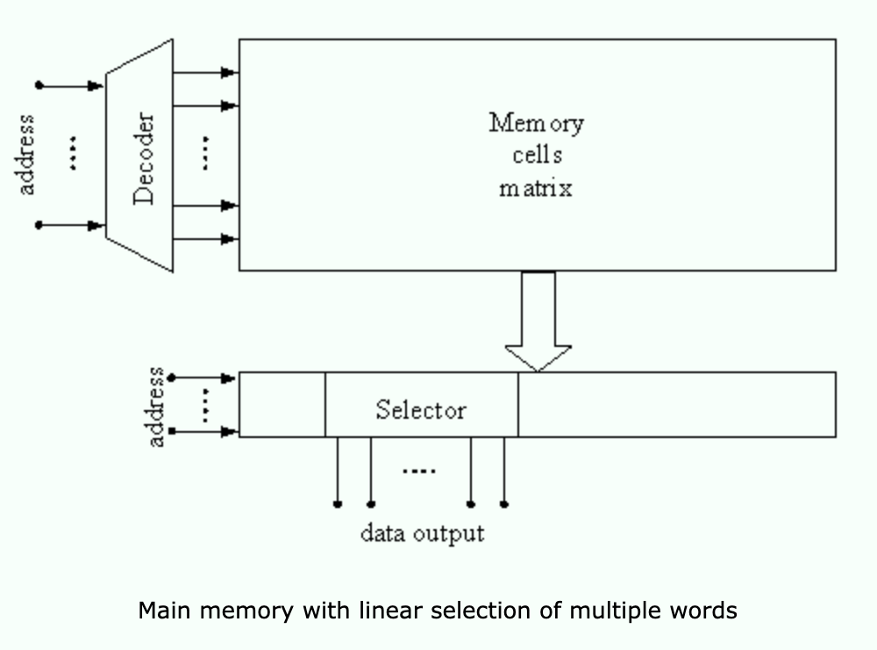
Main memory selection
Main memory with linear selection of multiple words
The structure of this type of main memory module is based on the memory with a single address decoder (linear selection). However, in this type of memory, each output line of address decoder activates not a single memory word cell but a sequence of memory word cells. After the readout from the memory matrix, these word sequences are introduced at inputs of a selector, i.e. a next selection unit that selects a single word out of them.

Slide 26
Main memory selection
Main memory with linear selection of multiple words
During memory write, data from the data bus are directed to the proper word cell in the sequence selected by the address decoder. The address is divided into two parts: one selects a given sequence of locations and the other is supplied to the selector circuit. In the selector, the second part of address is decoded and the output lines from the decoding select the memory locations to be used in the current memory operation.
In this type of main memory, the bit cells matrix is basically two-dimensional. However the information bits read from the matrix are subject to further selection, which is a half way in the direction towards a three-dimensional structure. For this reason this type of main memory is called 2.5 D memory.

